Slide 1
Discrete Mathematics (CSC 1204)
2.3 Functions

Slide 2
Functions
Definition 1: Let A and B be nonempty sets.
A function f from A to B is an assignment of exactly one element of B to each element of A.
We write f(a) = b if b is the unique element of B assigned by the function f to the element a of A.
If f is a function from A to B, we write f: A→B
Functions are also called mappings or transformations.

Slide 3
Functions
Functions are specified in many different ways.
Sometimes we explicitly state the assignments, as in Figure 1.
Often we give a formula, such as f(x) = x + 1, to define a function.
Other times we use a computer program to specify a function.

Slide 4
Functions
A function f: A→ B can also be defined in terms of a relation from A to B.
A relation from A to B is just a subset of A X B.
A relation from A to B that contains one, and only one, ordered pair (a, b) for every element a∈ A, defines a function f from A to B. This function is defined by the assignment f(a)=b, where ( a, b) is the unique ordered pair in the relation that has a as its first element.

Slide 5
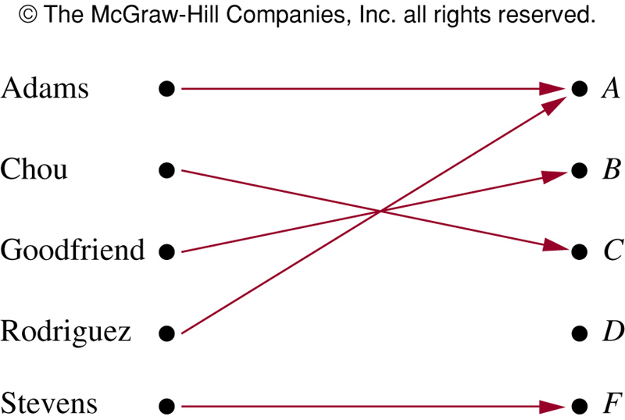
FIGURE 1: Assignment of Grades in a Discrete Mathematics Class

Slide 6
Some Function Terminology
Definition 2: If f is a function from A to B, we say that A is the domain of f and B is the codomain of f.
If f(a)=b, a is the preimage of b and b is the image of a.
Range of f is the set of all images of elements of A

Slide 7
Some Function Terminology
If f is a function from A to B, we say that f maps from A to B
f: A→ B
A: domain of f
B: codomain of f
f(a)=b,
a is called the preimage of b
b is called the image of a
Range of f : the set of all images of elements of A

Slide 8
Range versus Codomain
The range of a function might not be its whole codomain.
The codomain is the set that the function is declared to map all domain values into.
The range is the particular set of values in the codomain the function actually maps elements of the domain to.

Slide 9
Range versus Codomain: Example (See the FIGURE 1 in the previous slide)
Suppose I declare to you that: “f is a function mapping students in this class to the set of grades
{A, B, C,D,F}”.
At this point, you know f’s codomain is: {A, B, C,D,F}, and it’s range is unknown!
Suppose the grades turn out all As and Bs.
Then the range of f is {A, B}”, but it’s codomain is still {A, B, C,D,F}.

Slide 10
Example 1
What are the domain, codomain, and range of the function that assigns grades to students of Discrete Math class as follows?

Slide 11
Solution of Example 1
Solution:
Let G be the function that assigns grade to a student of DM class.
The domain of G is the set { Adams, Chou, Goodfriend, Rodriguez, Stevens}
The codomain of G is the set { A, B, C, D, F}
The range of G is the set { A, B, C, F}
Because each grade except D is assigned to some student

Slide 12
Example 2
Let R be the relation consisting of ordered pairs (Abdul, 22), (Brenda,24), (Carla,21), (Desire,22), (Eddie,24), and (Felicia,22), where each pair consists of a graduate student and the age of this student. What is the function that this relation determines?
Solution: This relation defines the function f, where with f(Abdul)= 22, f(Brenda)=24, f(Carla)=21, f(Desire)=22, f(Eddie)= 24, and f(Felicia)=22.
Here, domain is the set { Abdul, Brenda, Carla, Desire, Eddie, Felicia }
To define the function f, we need to specify a codomain. Here, we can take the codomain to be the set of positive integers
Range is the set {21,22,24}

Slide 13
Functions
Definition 3: Let f₁ and f₂ be functions from A to R. Then f₁+f₂ and f₁f₂ are also functions from A to R defined by
(f₁+f₂)(x) = f₁(x)+f₂(x)
(f₁f₂)(x) = f₁(x)f₂(x)

Slide 14
Example 6
Let f₁ and f₂ be functions from R to R such that f₁(x)=x² and f₂(x)=x – x² .
What are the functions f₁+f₂ and f₁f₂ ?
Solution:
(f₁+f₂)(x) = f₁(x)+f₂(x) = x² + (x –x² ) = x
(f₁f₂)(x) = x²(x- x² ) = x³ – x⁴

Slide 15
Functions
Definition 4: Let f be a function from the set A to the set B, and let S is a subset of A. The image of S under the function f is the subset of B that consists of the images of the elements of S.
We denote the image of S by f(S).
f(S) = {t|∃s∈S(t=f(s))}

Slide 16
Example 7
Let A = {a, b, c, d, e} and B = {1, 2, 3, 4}
with f(a)=2, f(b)=1, f(c)= 4, f(d)=1, f(e)=1.
What is the image of the subset S = {b, c, d}?
Solution:
The image of the subset S = {b, c, d} is the set
f(S) = {1, 4}

Slide 17
One-to-One Functions
Definition 5: A function f is one-to-one or injective, iff f(a)=f(b) implies that a=b for all a and b in the domain of f.
∀a∀b( f(a)=f(b) → a=b ) or ∀a∀b( a ≠ b → f(a) ≠ f(b) )
A function f: A→B is said to be one-to-one if different elements in the domain A have distinct images.
A function is one-to-one, iff every element of its range has exactly one pre-image.

Slide 18
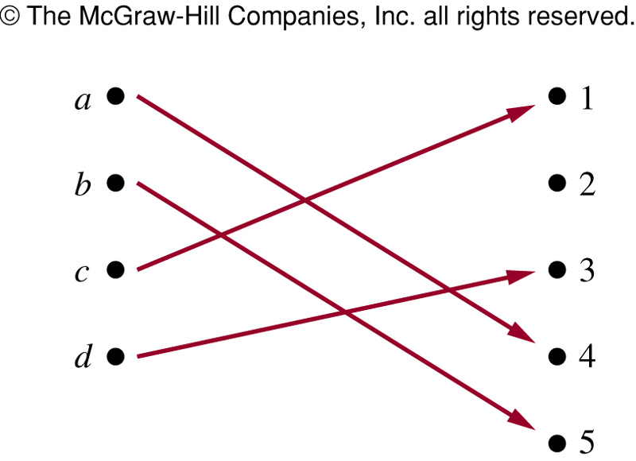
FIGURE: A One-to-One Function

Slide 19
Example 8
Determine whether the function f from {a, b, c, d} to {1, 2, 3, 4, 5} with f(a)=4, f(b)=5, f(c)= 1, and f(d)=3
is one-to-one.
Solution: The function f is one-to-one because f takes on different values at the four elements of its domain.

Slide 20
Example 9
Example 9: Determine whether the function f(x) = x² from the set of integers to the set of integers is
one-to-one.
Solution: The function f(x) = x² is not one-to-one because, for instance, f(1)= f(–1) = 1, but 1 = – 1
Question: Determine whether the function f(x) = x² from the set of positive integers to the set of positive integers is one-to-one.

Slide 21
Example 10
Determine whether the function f(x) = x + 1 from the set of real numbers to the set of real numbers is one-to-one.
Solution: The function f(x) = x + 1 is a one-to-one function. Since x+1 = y+1, when x = y

Slide 22
Example : One-to-one function
Let A = {1, 2, 3} and B = {a, b, c, d}, and
let f(1) = a, f(2) = b, f(3) = d.
Then f is injective, since the different elements 1, 2, 3 in A are assigned to the different elements a, c, d respectively in B

Slide 23
Onto Function
Definition 7: A function f from A to B is onto or surjective, iff for every element b∈B there is an element a∈A with f(a)=b.
∀y∃x( f(x)=y ) or ∀a∀b( a ≠ b → f(a) ≠ f(b) )
A function f: A→B is said to be an onto function if each element of B is the image of some element of A
A function f from A to B is onto if every element of B is the image of some element in A,
i.e., if B = range of f

Slide 24
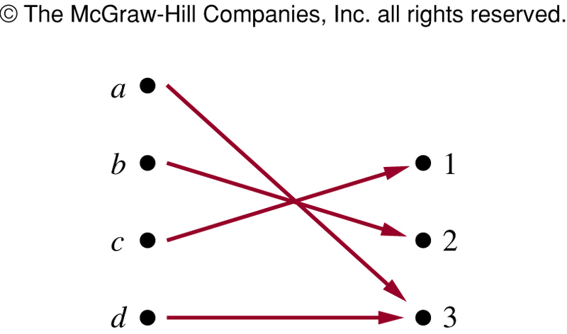
FIGURE: An Onto Function

Slide 25
Example 11
Let f be the function from {a, b, c, d} to {1, 2, 3} defined by f(a)=3, f(b)=2, f(c)=1, and f(d)=3.
Is f an onto? [see Fig. on last slide]
Solution: Because all three elements of the codomain are images of elements in the domain,
f is onto.

Slide 26
Example 12
Is the function f(x)=x² from the set of integers to the set of integers onto?
Solution: The function f is not onto, because there is no integer x with x² = –1, for instance.

Slide 27
One-to-one correspondence (bijection )
Definition 8: A function f is a one-to-one correspondence or a bijection if it is both one-to-one and onto.
Example: Let f be the function from A to B where A={1, 2, 3, 4} and B = {a, b, c, d} with f(1)=d, f(2)=b, f(3)=c, and f(4)=a, then f is bijective function.
f is one-to-one since the function takes on distinct values.
f is onto since every element of B is the image of some element in A.
Hence f is a bijection
Practice yourself: Example 14

Slide 28
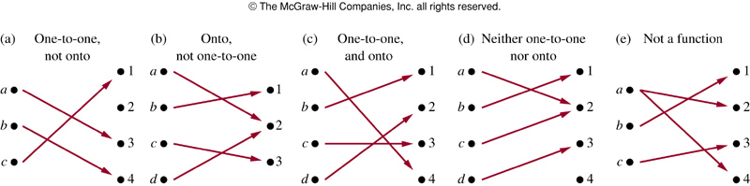
FIGURE: Examples of Different Types of Correspondences

Slide 29
Inverse Functions
Definition 9: Let f be a one-to-one correspondence from A to B. The inverse function of f is the function that assigns to an element b belonging to B the unique element a in A such that f(a)=b. Hence,
f⁻¹(b) = a , when f(a) = b

Slide 30
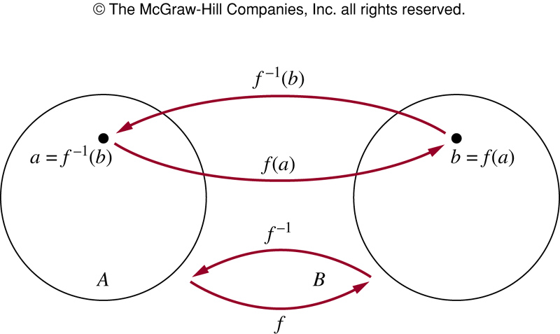
FIGURE The Function f ^{－1} Is the Inverse of Function f

Slide 31
Inverse Functions
A one-to-one correspondence is called invertible because we can define an inverse of this function.
A function is not invertible if it is not a one-to-one correspondence, because the inverse of such a function does not exist.

Slide 32
Example 16
Let f be the function from {a, b, c} to {1, 2, 3} such that f(a)=2, f(b)=3, and f(c)=1.
Is f invertible, and if it is, what is its inverse?
Solution: The function f is invertible because it is a one-to-one correspondence.
The inverse function f ⁻¹ reverses the correspondence given by f. So f ⁻¹ (1)=c, f ⁻¹ (2)=a, and f ⁻¹ (3)= b

Slide 33
Example 17
Let f: Z→Z be such that f(x) = x +1.
Is f invertible? and if it is, what is its inverse?
Solution: The function has an inverse because it is a one-to-one correspondence, as we have shown.
To reverse the correspondence, suppose that y is the image of x, so that y = x+1. Then x = y – 1.
This means that y – 1 is the unique element of Z that is sent to y by f. Consequently, f ⁻¹ (y) = y – 1

Slide 34
Example 18
Let f be the function from R to R with f(x)=x².
Is f invertible?
Solution: Because f(-2) = f(2) = 4, f is not one-to-one.
[ If an inverse function were defined, it would have to assign two elements to 4. Hence, f is not invertible.]

Slide 35
Compositions of Functions
Definition: Let g be a function from the set A to the set B and let f be a function from the set B to the set C.
The composition of functions f and g, denoted by f o g, is defined by
(f o g) (a) = f(g(a))
Note: f o g and g o f are not equal
Note: The composition f o g can NOT be defined unless the range of g is a subset of the domain of f

Slide 36
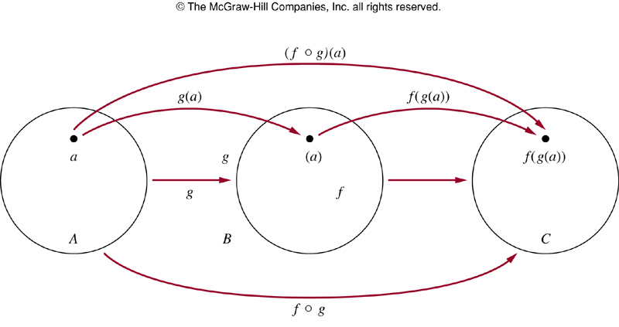
FIGURE 7 (2.3)
FIGURE The Composition of the Functions f and g.
Notes:
p:\msoffice\My Projects\Rosen 6e 2007\Imagebank\JPEGs07-24-06\ch02\jpeg\02-3-007.jpg

Slide 37
Modified Example 21 @ p. 141(6th) @ p.149 (7th)
Let f and g be the functions from the set of integers to the set of integers defined by f (x) = 2x + 3 and
g (x) = 3x + 2. Find the composite functions of f and g.
Solution:
The composition of the functions f and g is
(f o g) (x) = f(g(x)) = f (3x+2) = 2(3x+2) + 3 = 6x + 7
The composition of the functions g and f is
(g o f) (x) = g(f(x)) = g(2x+3) = 3(2x+3) + 2 = 6x + 11
Practice @ Home: Example 20 (p.149)

Slide 38
Some Important Functions
Two important functions in discrete mathematics. These functions are often used when objects are counted. They play an important role in the analysis of the number of steps used by procedures to solve problems of a particular size.
Floor function
Ceiling Function
The floor and ceiling functions map the real numbers
onto the integers (R→Z).

Slide 39
Floor Function
The floor function assigns to the real number x the largest integer that is less than or equal to x.
Let x be a real number. The floor function rounds x down to the closest integer less than or equal to x.
The value of the floor function at x is denoted by ⎣x⎦
Examples: ⎣2.3⎦ = 2, ⎣2⎦ = 2, ⎣0.5⎦ = 0, ⎣-3.5⎦ = -4

Slide 40
Ceiling Function
The ceiling function assigns to the real number x the
smallest integer that is greater than or equal to x.
The value of the ceiling function at x is denoted by ⎡x⎤
Examples: ⎡2.3⎤ = 3, ⎡2⎤ = 2, ⎡0.5⎤ = 1, ⎡-3.5⎤ = -3

Slide 41
Floor & Ceiling Functions: Examples
How many bytes are required to encode 600 kilobits of data? [Note: Each byte is made up of 8 bits]
Answer: ⎡(600X1000)/8⎤ = 75000 bytes
How many bytes are required to encode 1001 bits of data?
Answer: ⎡1001/8 ⎤ = 126 bytes
Practice @ Home: Example 25 (p.151)

Slide 42
Example 26 @ p.152
In asynchronous transfer mode (ATM), data are organized into cells of 53 bytes. How many ATM cells can be transmitted in 1 minute over a connection that transmits data at the rate of 500 kilobits per second?
Solution: In 1 minute this connection can transmit 500.1000.60 bits = 30,000,000 bits
Each ATM cell is 53 bytes long, which means that it is
53.8 = 424 bits long
Number of ATM cells that can be transmitted is
= ⎣ 30,000,000/424 ⎦ = 70,754

Slide 43
Practice @ Homework
Relevant odd-numbered exercises

